Slide 1
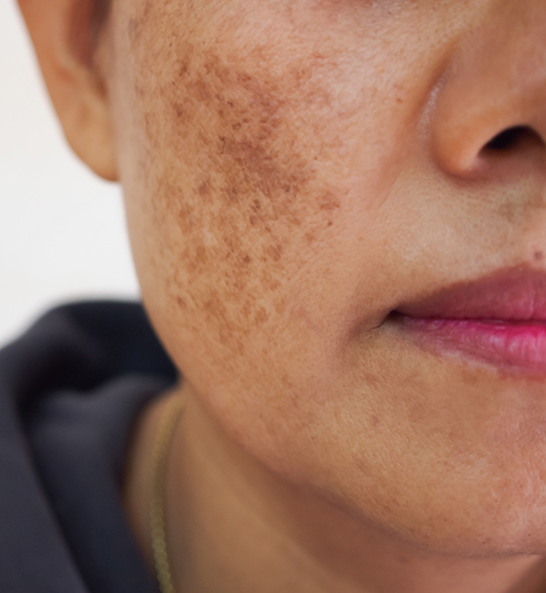
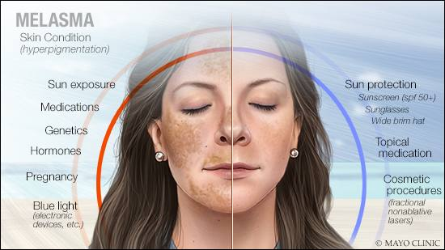
Melasma
Aya Yousef Badran
Associate Professor of Dermatology , Andrology and Venereology
Faculty of Medicine-Assiut University

Slide 2
Learning Outcomes:
Define Melasma.
Mention the epidemiology and etiology of Melasma.
Describe clinical features of Melasma.
Describe how to Diagnose and treat Melasma.
Source:
Amboss medical learning platform

Slide 3
Contents
Definition:
Epidemiology:
Etiology :
Clinical features:
Diagnosis:
Treatment:

Slide 4

What is Melasma?

Slide 5
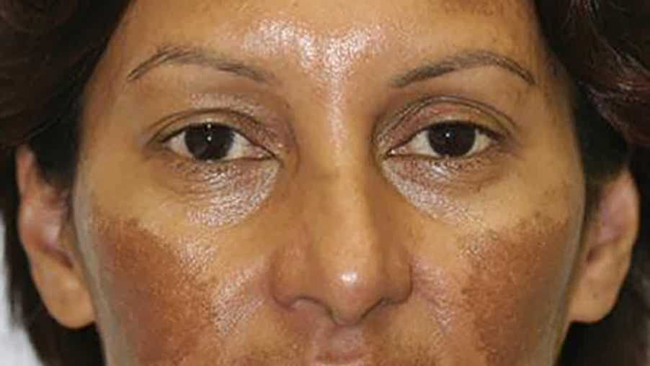

Melasma
Definition: a benign disorder characterized by hyperpigmentation of the skin that is associated with pregnancy and oral contraceptive use .
It is a common acquired skin disorder that presents as a bilateral, blotchy, brownish facial pigmentation.

Slide 6
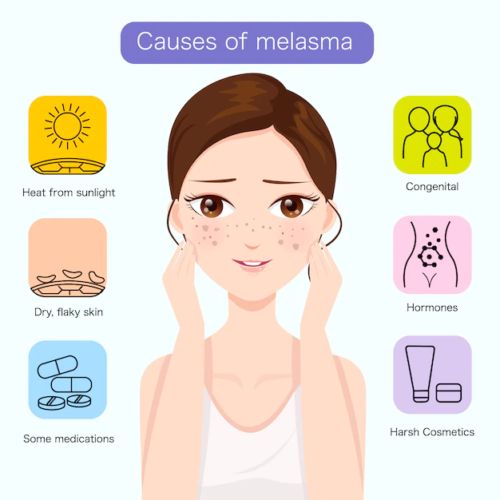
Epidemiology
  Common in dark-skinned individuals.
  Incidence in ♀ > ♂
Etiology
  Pregnancy: referred to as “mask of pregnancy
  Hormonal contraceptives
  Neoplastic diseases that produce hormones.

Slide 7
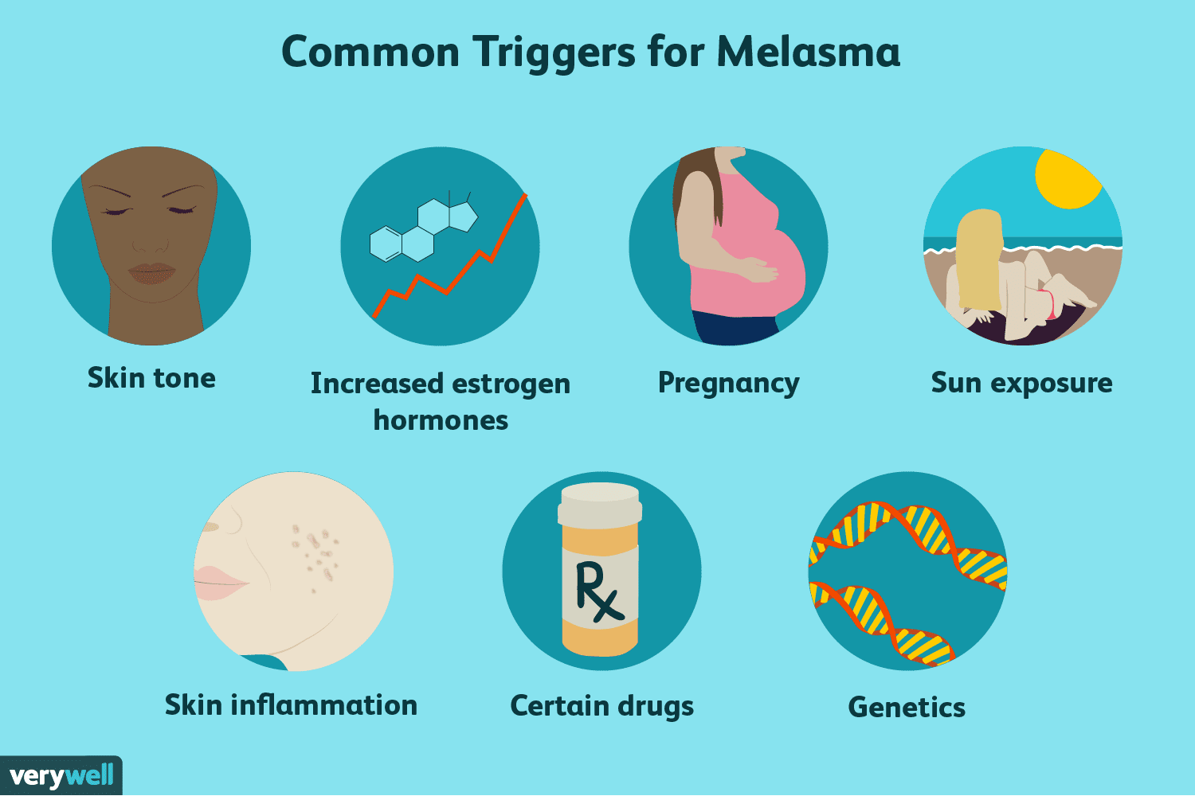

Slide 8

Clinical features :
  Hyperpigmented lesions on the face.
  Exacerbated by exposure to sunlight (UV radiation) .
  Melasma presents as bilateral, asymptomatic, light-to-dark brown macules or patches with irregular borders.

Slide 9
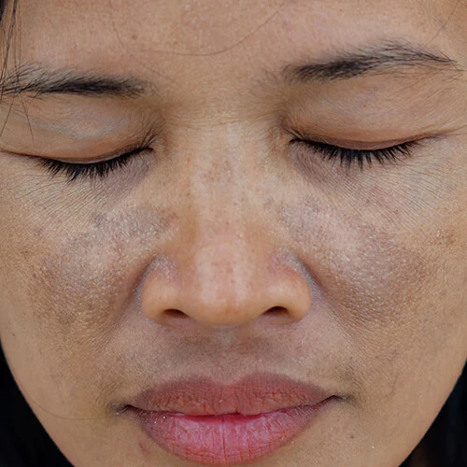

Slide 10
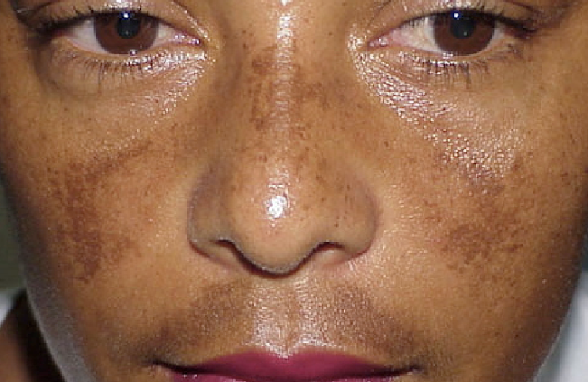

Slide 11


Slide 12
  Distinct patterns include:
  Centrofacial : forehead, cheeks, nose, upper lip ; 50-80% of presentations.
  Malar : cheeks, nose.
  Mandibular : jawline, chin.
Diagnosis:
Clinical diagnosis

Slide 13


Slide 14


  Sunscreen.
  Topical depigmenting agents alone or, more commonly, in combination as:
      Hydroquinone.
      Azelaic acid.
      Kojic acid.
      Ascorbic acid.
      Tranexamic acid.

Slide 15
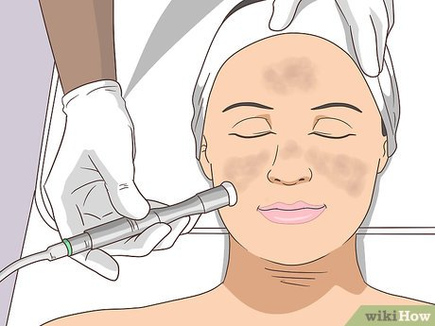
Other lines:
      Chemical peeling.
      Microdermabrasion.
      Platelet Rich plasma (PRP).
      Laser.

Slide 16


